Slide 1
Deep content-based music recommendation
A¨aron van den Oord, Sander Dieleman, Benjamin Schrauwen
Park, Jun Sep

Slide 2



Goal
Latent factor model for recommendation
The latent factors from music audio when they cannot be obtained from usage data (implicit feedback)

Slide 3
Challenge – traditional method
Collaborative filtering approach
Cold Start Problem
- Usage Data is scarce
- Necessity of rating information (explicit feedback)

Slide 4
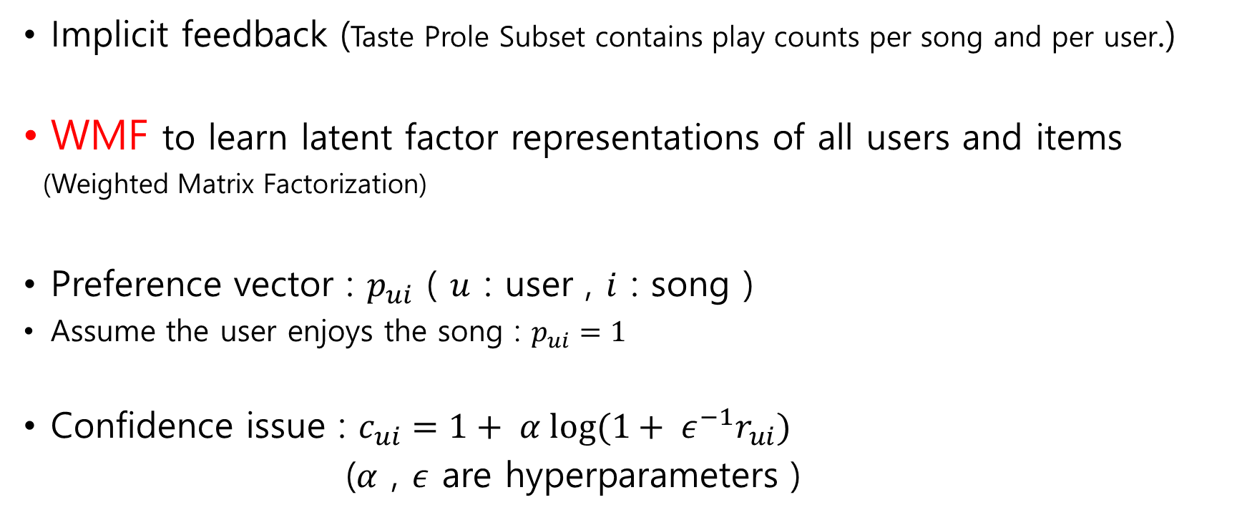
Latent Factor
Implicit feedback (Taste Prole Subset contains play counts per song and per user.)
WMF to learn latent factor representations of all users and items
(Weighted Matrix Factorization)
Preference vector : $p_{ui}$ ( $u$ : user , $i$ : song )
Assume the user enjoys the song : $p_{ui}=1$
Confidence issue : $c_{ui}=1+ α log⁡(1+ ε^{−1}r_{ui})$
($α$ , $ε$ are hyperparameters )

Slide 5
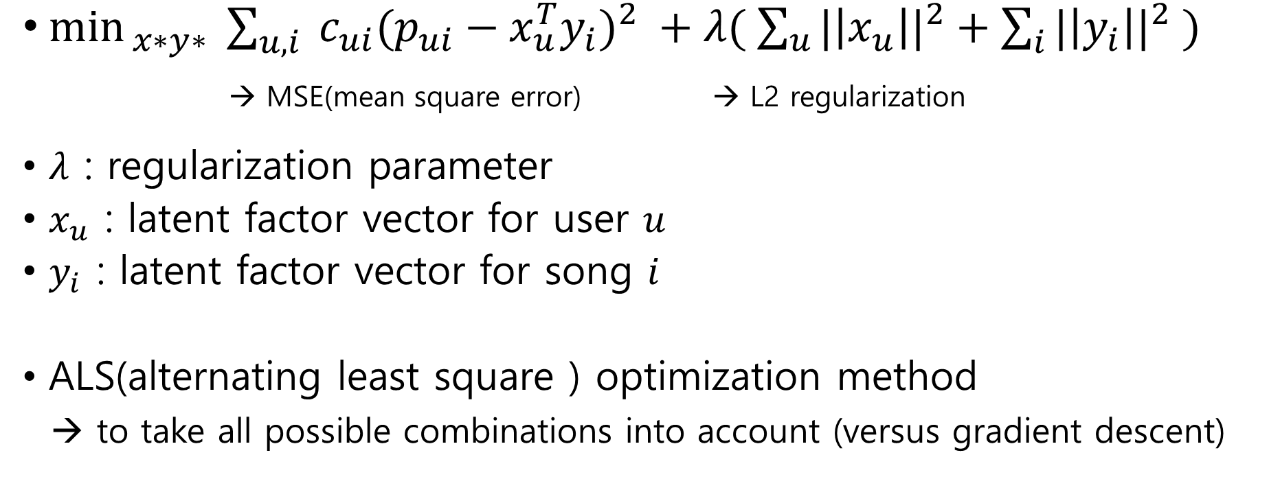
WMF objective function
$\min_{ x∗y∗}{\sum_{u, i}{ {c_{ui}(p_{ui}−x_{u}^{T}y_{i})}^{2} }}+λ( \sum_{u}{{|\left|x_{u}\right||}^{2}}+\sum_{i}{{|\left|y_{i}\right||}^{2}} )$
→ MSE(mean square error) → L2 regularization
$λ$ : regularization parameter
$x_{u}$ : latent factor vector for user $u$
$y_{i}$ : latent factor vector for song $i$
ALS(alternating least square ) optimization method
→ to take all possible combinations into account (versus gradient descent)

Slide 6
Predicting (music audio → latent factors)
Time series (audio signal) → vector of real numbers
Converting ~ Regression Problem
2 Methods
- BOW (bag-of-words) : input to a classifier / regressor
- CNN : Convolutional neural network
( state-of-the-art speech recognition )

Slide 7
CNN ( convolutional neural network )
Ingredients of the Network
1. ReLU (vanishing problem)
2. Theano library ( GPU acceleration )
3. MSD training data
MFCCs : (method) extracting the characteristics of sound
→ analyzing the spectrum of intervals by dividing a short term

Slide 8
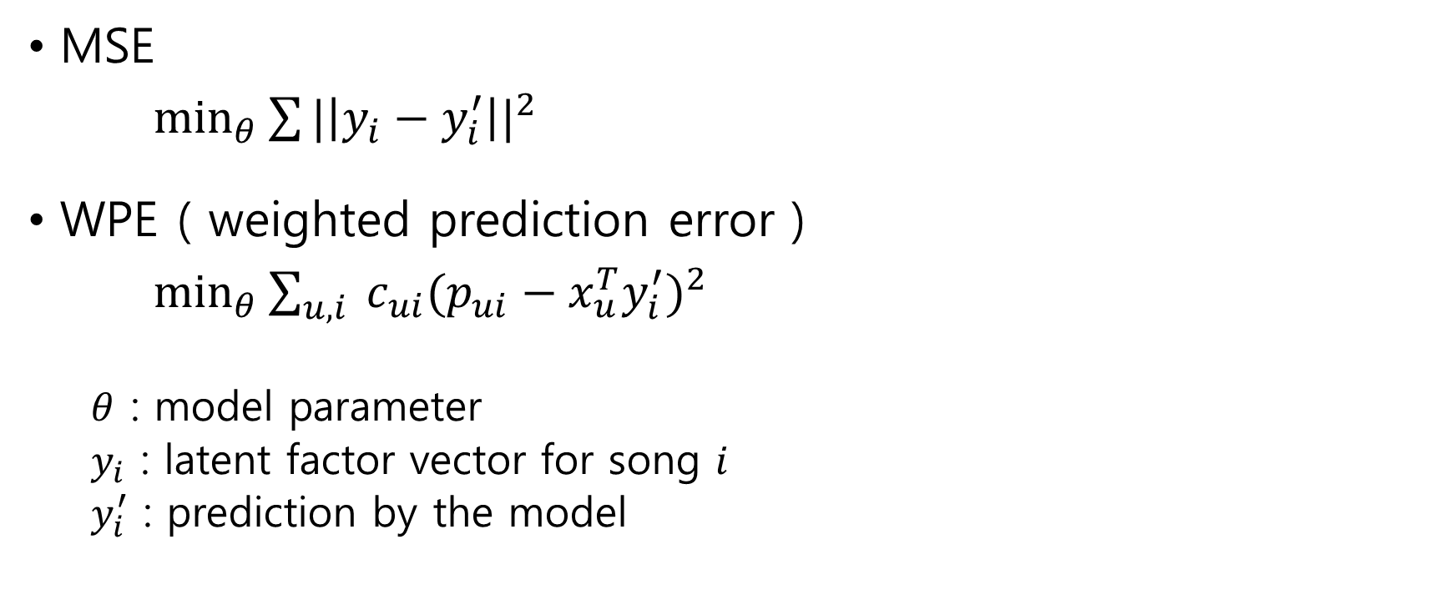
Objective function for real value
MSE
$\min_{θ}{\sum{{|\left|y_{i}−y_{i}^{′}\right||}^{2}}}$
WPE ( weighted prediction error )
$\min_{θ}{\sum_{u, i}{ c_{ui}{(p_{ui}−x_{u}^{T}y_{i}^{′})}^{2}}}$
$θ$ : model parameter
$y_{i}$ : latent factor vector for song $i$
$y_{i}^{′}$ : prediction by the model

Slide 9
Dataset
MSD ( million song dataset )
precomputed audio feature
1 million contemporary songs
Taste Profile Subset ( play counts : over 380,000 songs )
Last.fm ( tagging for over 500,000 songs)
7digital.com
29 seconds audio clips for 99% of the dataset

Slide 10
Experiment 1 - quantitative
<< MLR >>
MLR(Multiple Linear regression)
input : bag-of-words representation
<< linear MLP >>
linear regression using latent factor vectors with 400 dimensions
input : bag-of-words representation
<< CNN >>
CNN trained on log-scaled , latent factor vectors with 50 dimensions
- minimizing MSE
- minimizing WPE

Slide 11
Experiment 1 - quantitative
Initial experiments
- the 9,330 most popular songs & listening data for only 20,000 users
- 1,881 songs for testing
other experiments, we used all available data
- 382,410 songs and 1 million users in total
- 46,728 songs for testing
evaluation index
- mean average precision (mAP)
- area under the ROC curve (AUC)

Slide 12
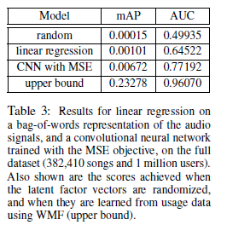
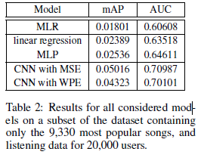
Experiment 1 - quantitative
Based on subset of the dataset
Based on audio signal
Upper bound
→ latent factor vectors are obtained from usage data

Slide 13
Experiment 1 - quantitative
Interestingly, the WPE objective does not result in improved performance.
→ latent factor vectors for popular songs, at the expense of
all other songs.
Limitation: we are unable to predict the popularity of the songs, which considerably affects the AUC and mAP scores.

Slide 14
Experiment 2 - qualitative
Comparing
- cosine similarity : the predicted usage patterns
- WMF : latent factors (50 dimensions)
Result
- mostly different
- quite reasonable in the sense

Slide 15
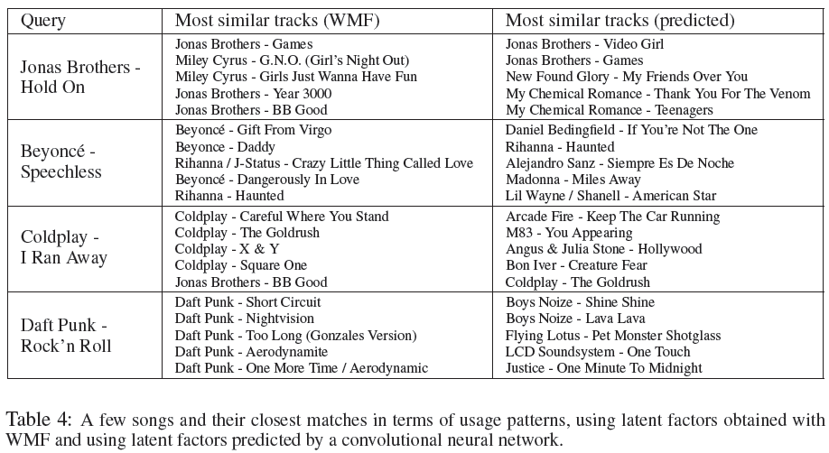

Slide 16
Experiment 2 - qualitative
Visualization
- distribution of prediction ( two dimensions using t-SNE )
Result
- Well clustered
- Appealing to the same audience

Slide 17
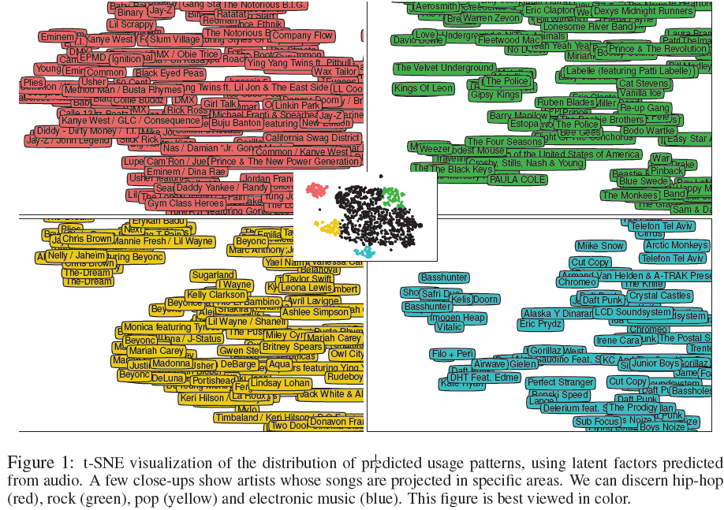

Slide 18
Result
Predicting latent factors from music audio is a viable method for recommending new and unpopular music.
CNN significantly outperforming the traditional approaches.
Prediction from audio signals seem to be sensible.

